Slide 1
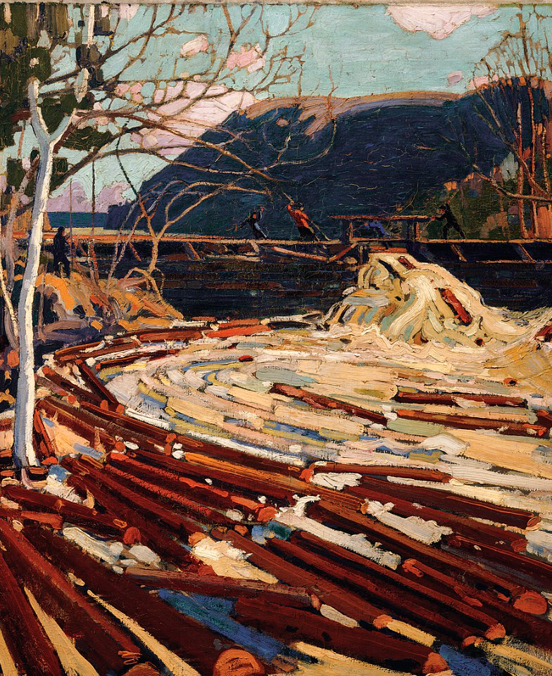

From EIA to Waste
IL “Sustainability & Environmental Management” SS 25
Kami Höferl
(Thomson, 1916, PD)

Slide 2
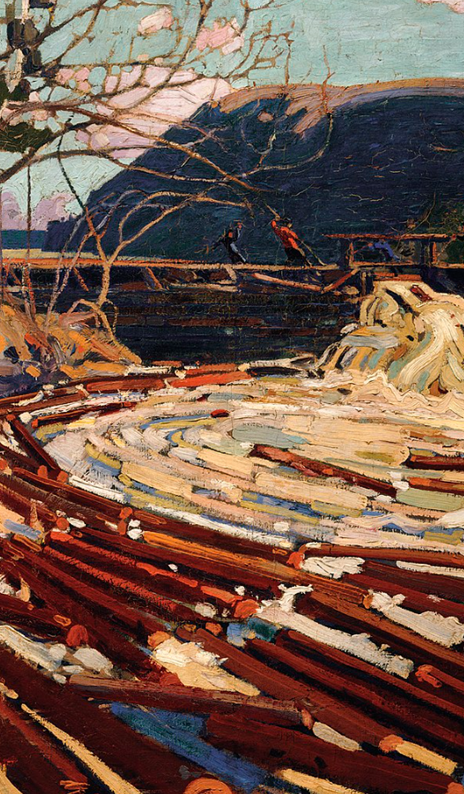
Overview
A Look in the Toolbox
Where to Start?
Environmental Impact Assessment
Licensing an Operational Facility
Some Conclusions
Waste Management Concept
(Thomson, 1916, PD)
(Escher, 1961)

Slide 3
Where Did we Stop Last Time?
🤔

Slide 4
So …

Slide 5

So …
👉 give me the tools & we manage it!

Slide 6
A Selection of Tools:
 | Focus on …
 | Substance |  | Procedure
Voluntary
Mandatory
Carbon Neutral
Cradle to Cradle
Further CSR activites
Life Cycle Assessment
Österr. Umweltzeichen
B-Corp
ESG reporting: GRI, SASB, ISSB etc.
Climate-focused reporting: TCFD & CDP
Social-focused standards: SA8000
Sector-specific standards: OECD Due Diligence Minerals
XY
Environmental Management
Sustainability Management
EU CSRD
ISO 14001 EMAS
XY
EU Industrial Emissions Directive (IED)
EU Corporate Sustainability Due Diligence Directive (CSDDD)
EU Emissions Trading System (ETS)
EU Green Claims Directive
Env. Impact Assessment (EIA)
Nat. regulations on air, waste, water & soil

Slide 7
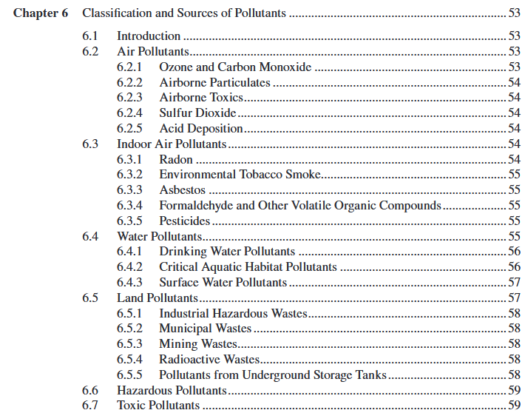
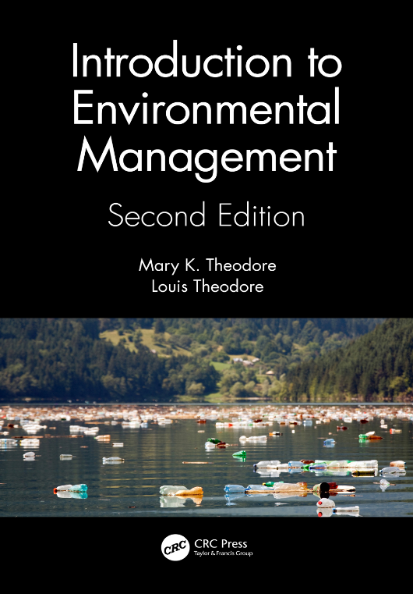
Where to Start?

Slide 8

Where to Start? At the Beginning

Slide 9


Where to Start? At the Beginning

Slide 10
Where to Start? At the Beginning
What are the projected environmental consequences of this undertaking?

Slide 11
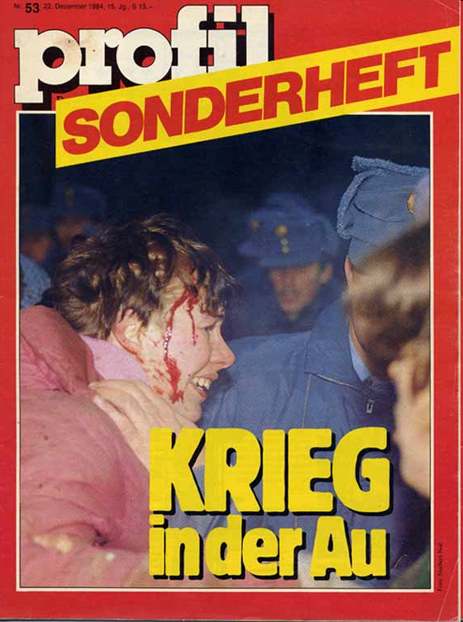
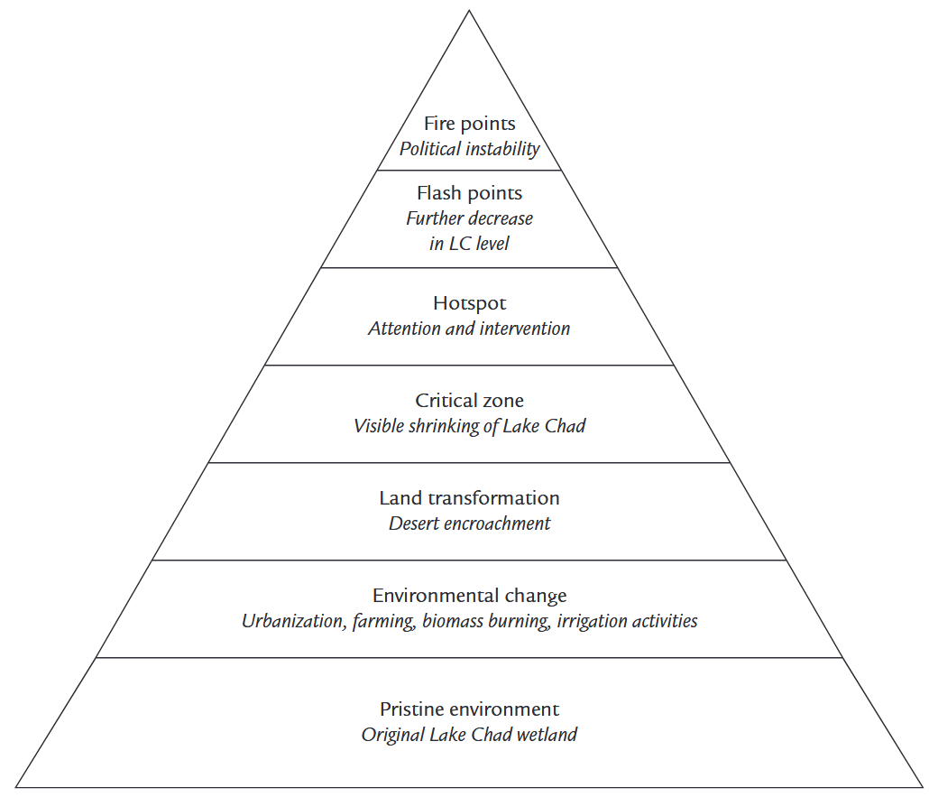
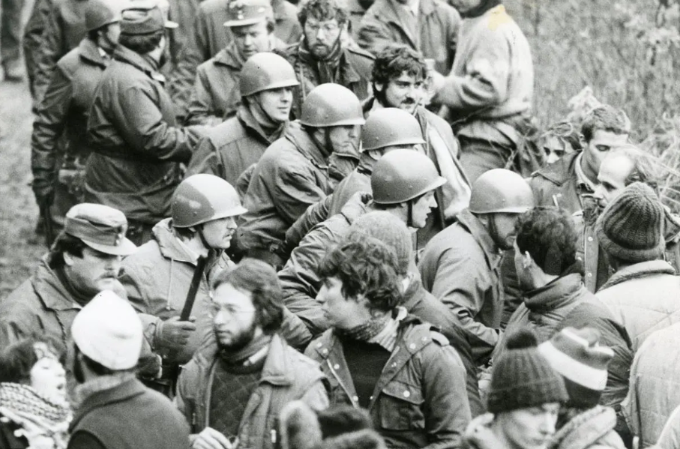
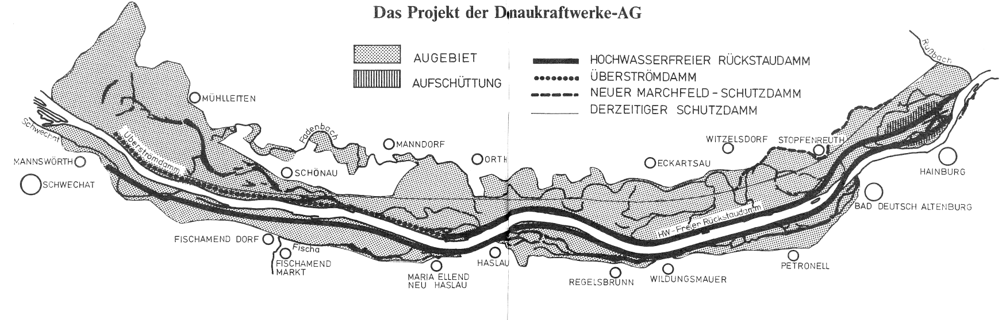
Flashback: Corporate Responsibility beyond Friedman

Slide 12

Where to Start? At the Beginning
 | Focus on …
 | Substance |  | Procedure
Voluntary
Mandatory
Carbon Neutral
Cradle to Cradle
Further CSR activites
Life Cycle Assessment
Österr. Umweltzeichen
B-Corp
ESG reporting: GRI, SASB, ISSB etc.
Climate-focused reporting: TCFD & CDP
Social-focused standards: SA8000
Sector-specific standards: OECD Due Diligence Minerals
XY
Environmental Management
Sustainability Management
EU CSRD
ISO 14001 EMAS
XY
EU Industrial Emissions Directive (IED)
EU Corporate Sustainability Due Diligence Directive (CSDDD)
EU Emissions Trading System (ETS)
EU Green Claims Directive
Env. Impact Assessment (EIA)
Nat. regulations on air, waste, water & soil

Slide 13
Environmental Impact Assessment

Slide 14
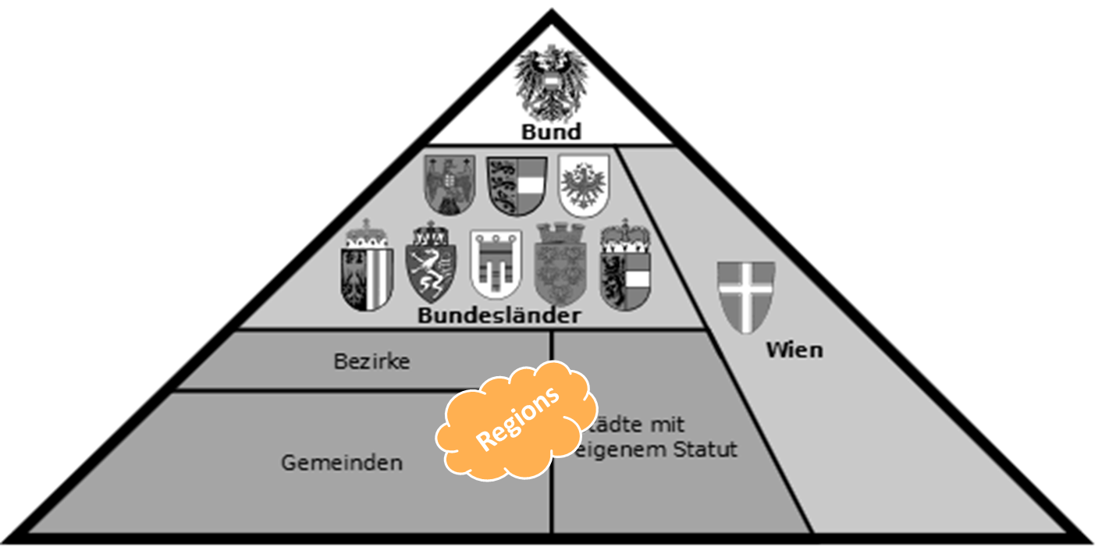
Goals of EIA
For “big” projects: Precautionary principle 👉 proactively avert environmental harm before it occurs
Identify project-related, cross-media environmental impact assessment of
planned facilities and
project variants
Include affected stakeholder 👉 transparency
Streamlining authorisation procedure

Slide 15
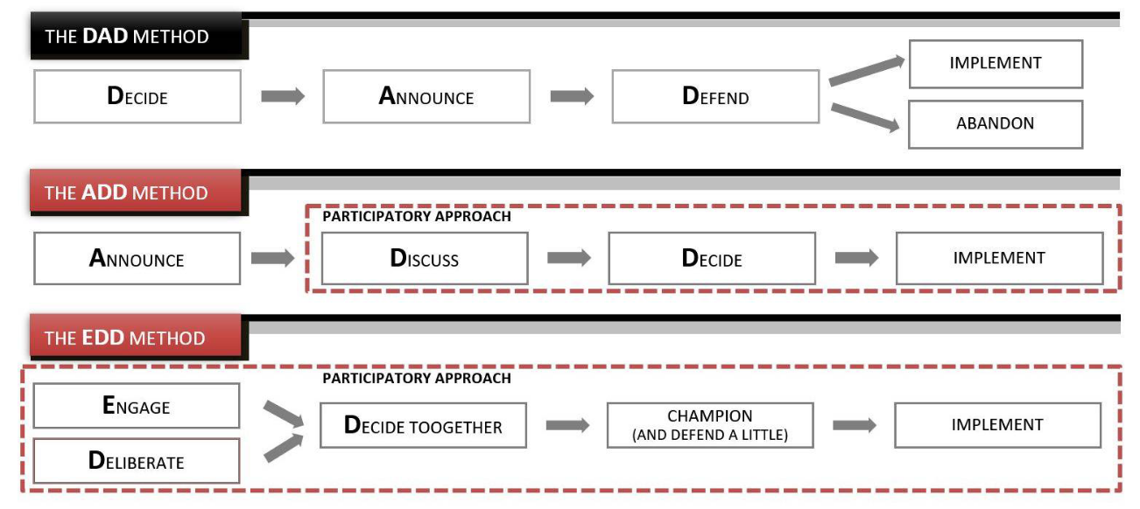
@ Include: Work towards “License to Operate”

Slide 16
Flashback: Corporate Responsibility beyond Friedman

Slide 17
@ Streamlining
For complex projects: 👉 More than one authorisation required
Building permit
Clearing authorisation
Operating licence
Air emissions
Noise emissions
Vibrations
Electricity supply & safety
Health & Safety regulations for employees & neighbours
water rights notice
…
One-Stop-Shop strategy

Slide 18
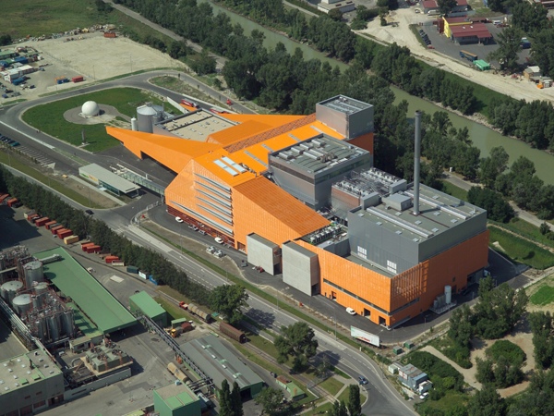



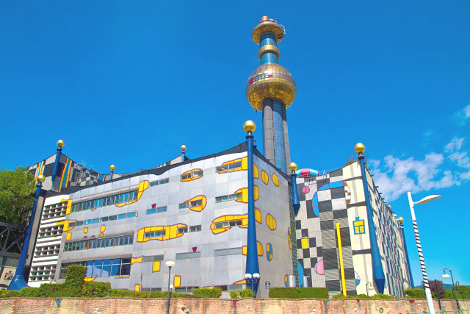
Factual Reach of EIAs
Variante

Slide 19
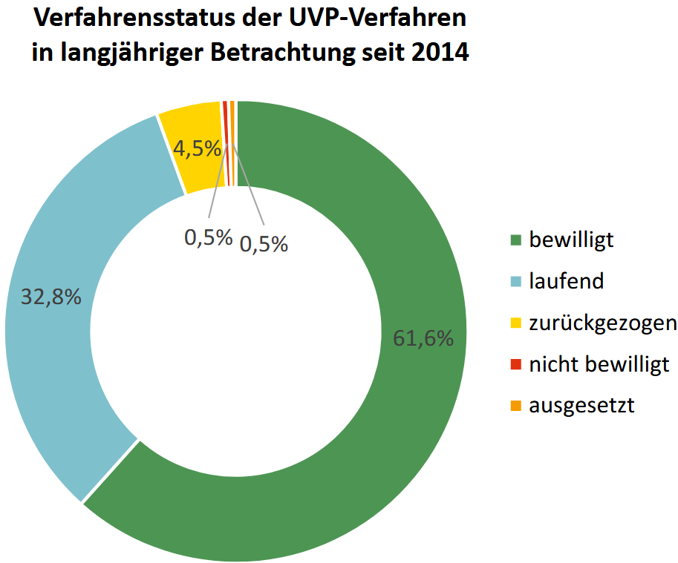
Factual Reach of EIAs

Slide 20
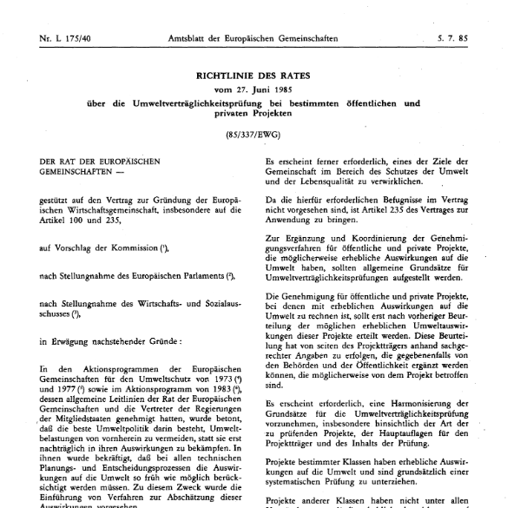
Wer hat’s erfunden? Or: A quick History of EIA
Rather old idea:
1969: US National Environmental Policy Act (NEPA)
1985: EU Directive 85/337/EWG
1993: Umweltverträglichkeits-prüfungsgesetz (UVP-G)
2000: UVP-G 2000

Slide 21
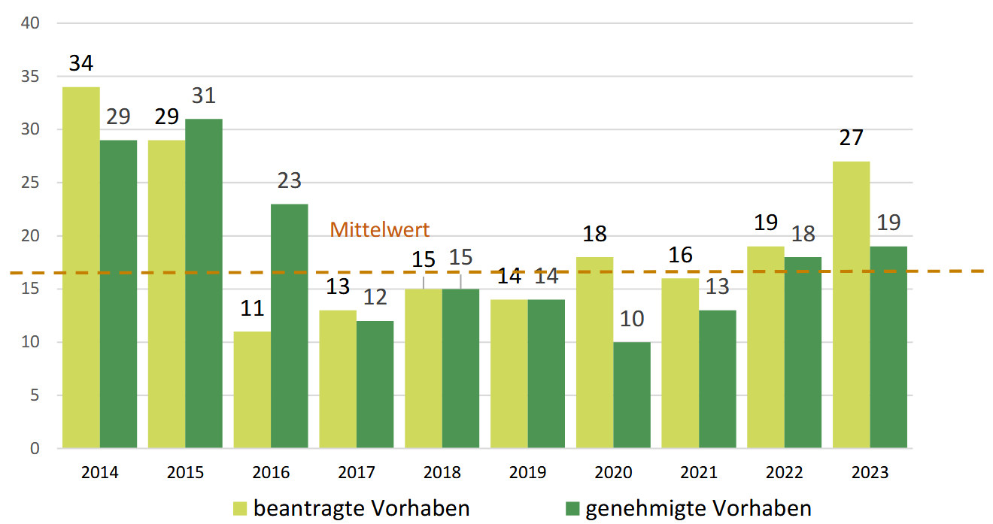
Just did it! EIA in Austria 2014-2023

Slide 22
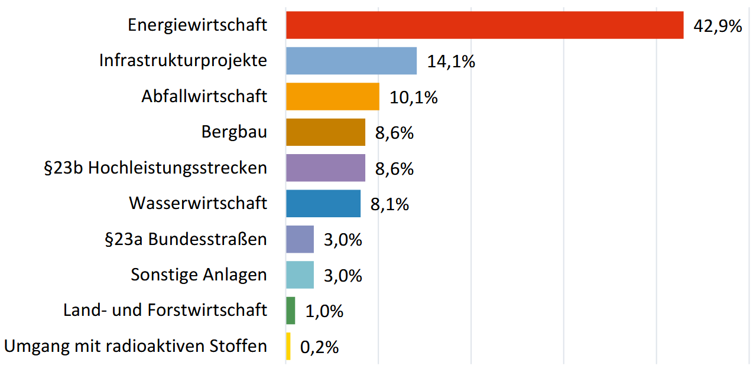
Just did it! EIA in Austria 2014-2023

Slide 23
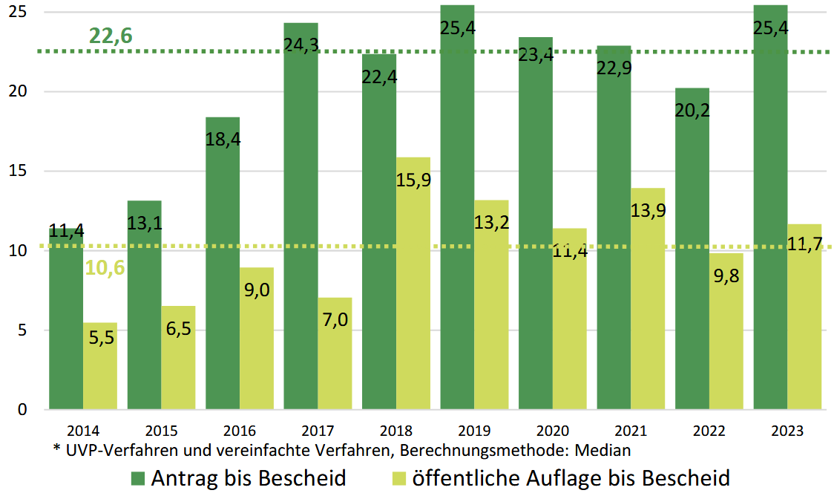
Just did it! Duration of EIAs in Austria 2014-2023

Slide 24
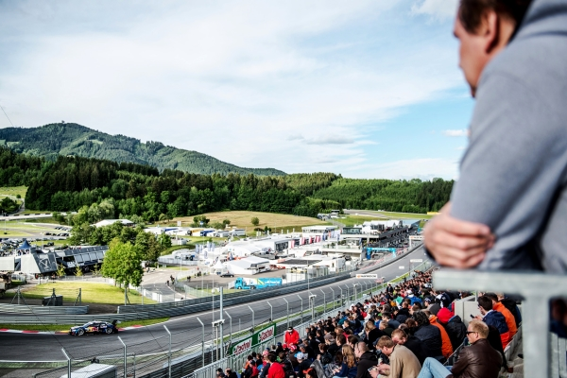
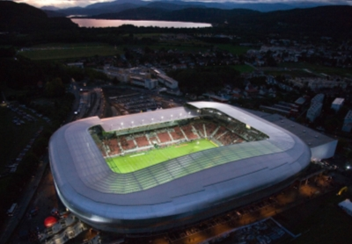
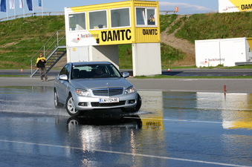
UVP-G as Work in Progress (Novelle 2005)

Slide 25
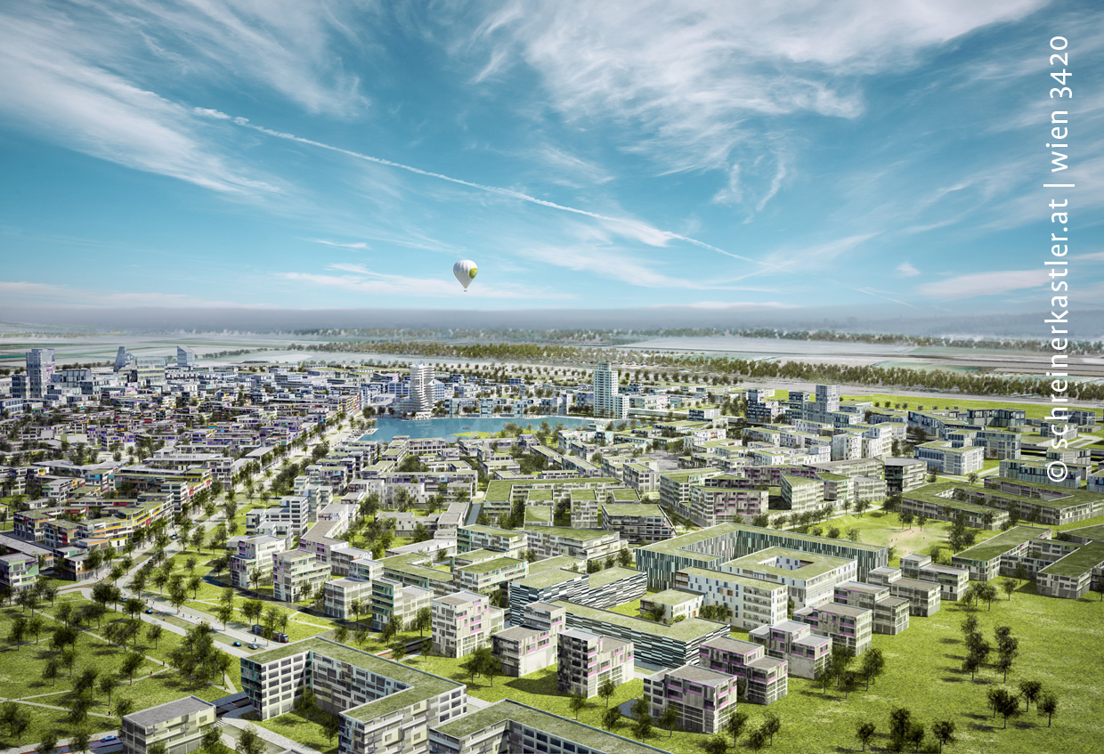
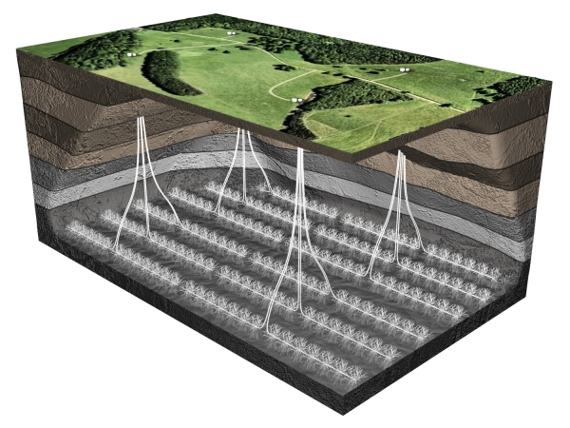
UVP-G as Work in Progress (Novelle 2012)

Slide 26
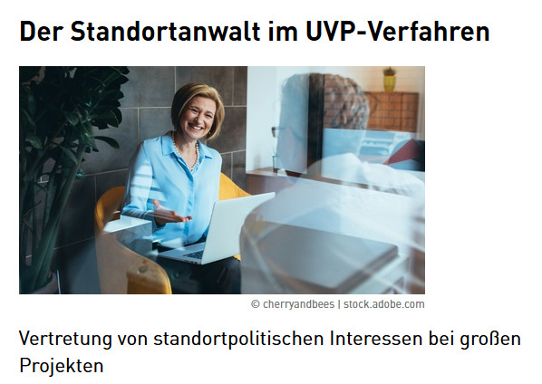
UVP-G as Work in Progress (Novelle 2018)
NGOs as “Partei” > 100 members
Standortanwälte as equivalent to Umweltanwälte

Slide 27
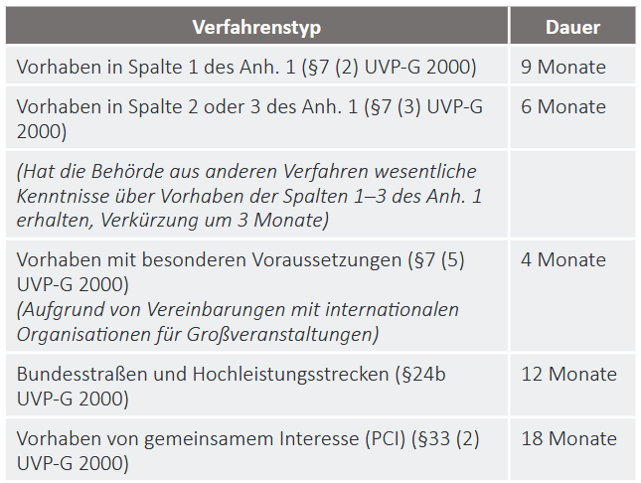
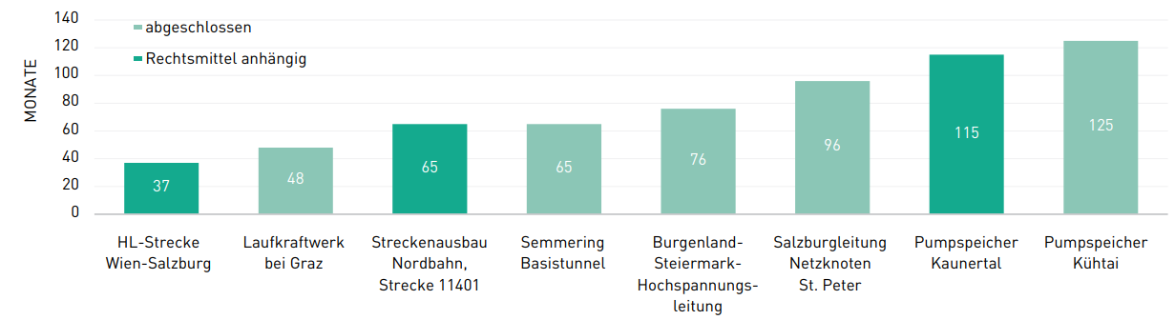
UVP-G as Work in Progress (Novelle 2023)
Limiting duration of assessment

Slide 28
Some important Questions
Which actors are involved?
environmental authority
What are the goals of an EIA?
What needs to be assessed?
Projects with "significant environmental impacts”
What procedure is used in an EIA?
EIA vs. simplified EIA

Slide 29
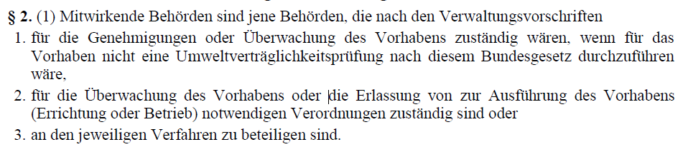
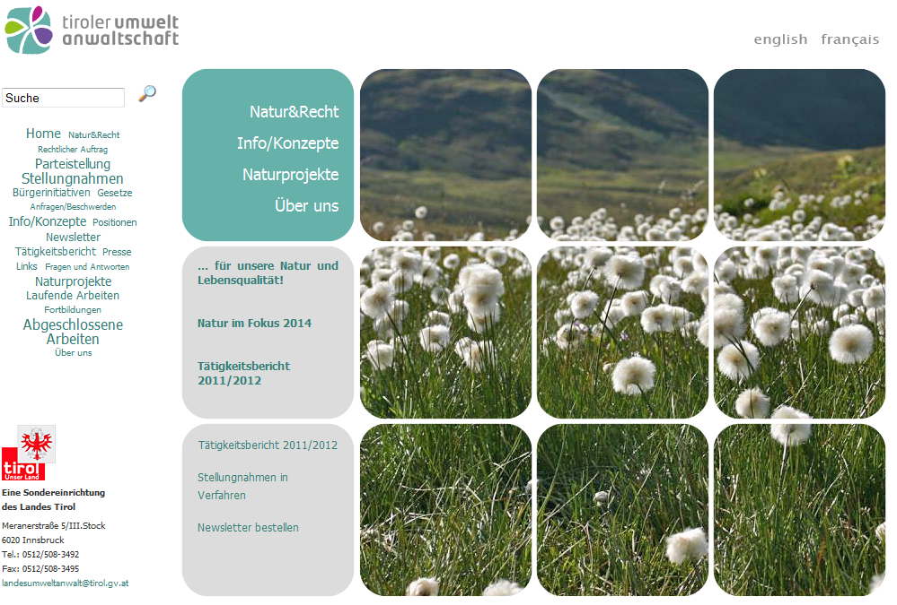
Which Actors are Involved?
Project applicant
Participating authorities:
Umweltanwaltschaften:
Independent organisation of the federal states 👉 freedom from instructions
represent the public interest in the environment & nature conservation in administrative proceedings

Slide 30
Which Actors are Involved?
Project applicant
Participating authorities:
Federal state authorities, district administrative authorities
Umweltanwaltschaften
Standortanwälte: WKO
Independent federal organization 👉 freedom from instructions
Represents public interests that speak in favour of the realisation of a project
Affected stakeholder aka “Parteien”: Neighbours & NGOs
General public

Slide 31
What are the goals of an EIA?
With public participation: Assess (in)direct project-related impacts (incl. interactions) on
Humans, animals, plants & habitats
Soil, water, air & climate
Landscape
Material & cultural assets
Measures for prevention & reduction
Advantages & disadvantages of the project-variants incl. omission of the project (“Nullvariante")
In the case of expropriation: environmentally relevant advantages & disadvantages
= „Schutzgüter“

Slide 32

What needs to be assessed? 👀 UVP-G Annex 1
UVP-pflichte Vorhaben: Vollständiges UVP-Verfahren notwendig
UVP-pflichte Vorhaben: Verkürztes UVP-Verfahren notwendig
→ aufgrund Qualität & Quantität: „geringere“ erwartbare Auswirkungen
UVP-Pflicht unter „besonderen Voraussetzungen“: ev. Verkürztes UVP-Verfahren
Bezugnahme auf „schutzwürdige Gebiete“
Schwellenwerte → Einzelfallprüfung → vereinfachtes Verfahren

Slide 33
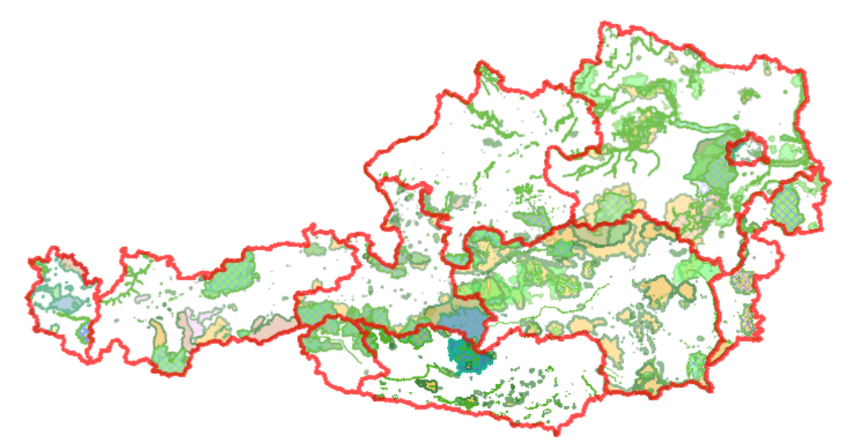
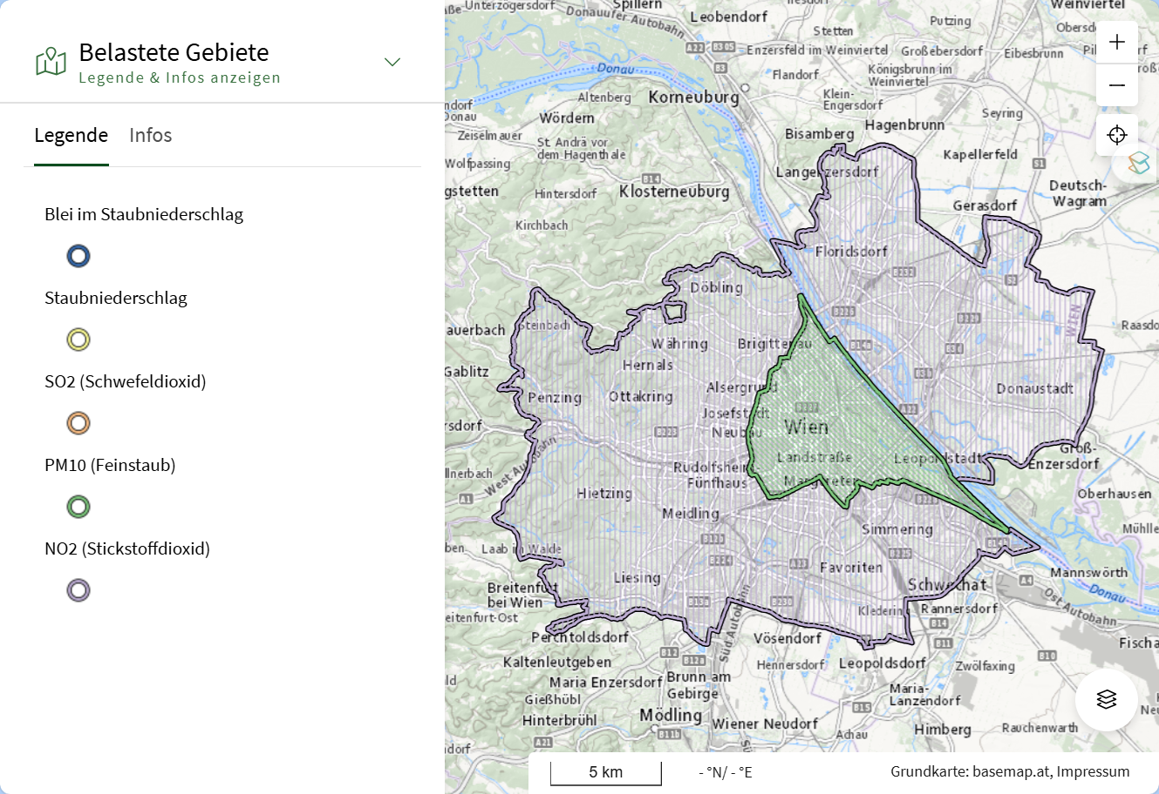
What needs to be assessed? 👀 UVP-G Annex 1
“Schutzwürdige Gebiete”:
Nature reserves
Natura-2000 areas
Alpine areas: above treeline (cf. § 2 ForstG 1975)
Water protection areas
Area in which the air is already heavily polluted:
Belastete Gebiete (Luft) 2019
Near a residential areas = 300m proximity

Slide 34
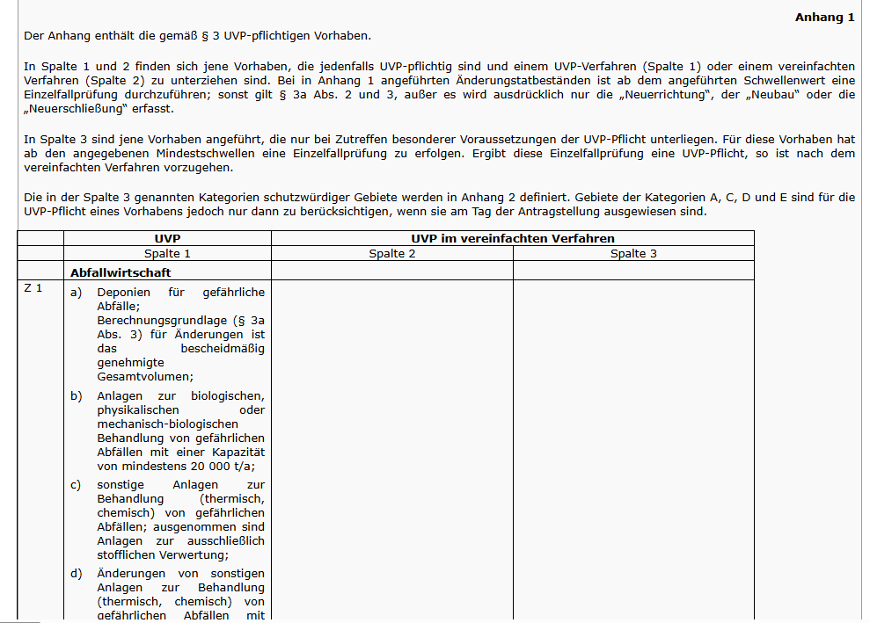
What needs to be assessed? 👀 UVP-G Annex 1

Slide 35
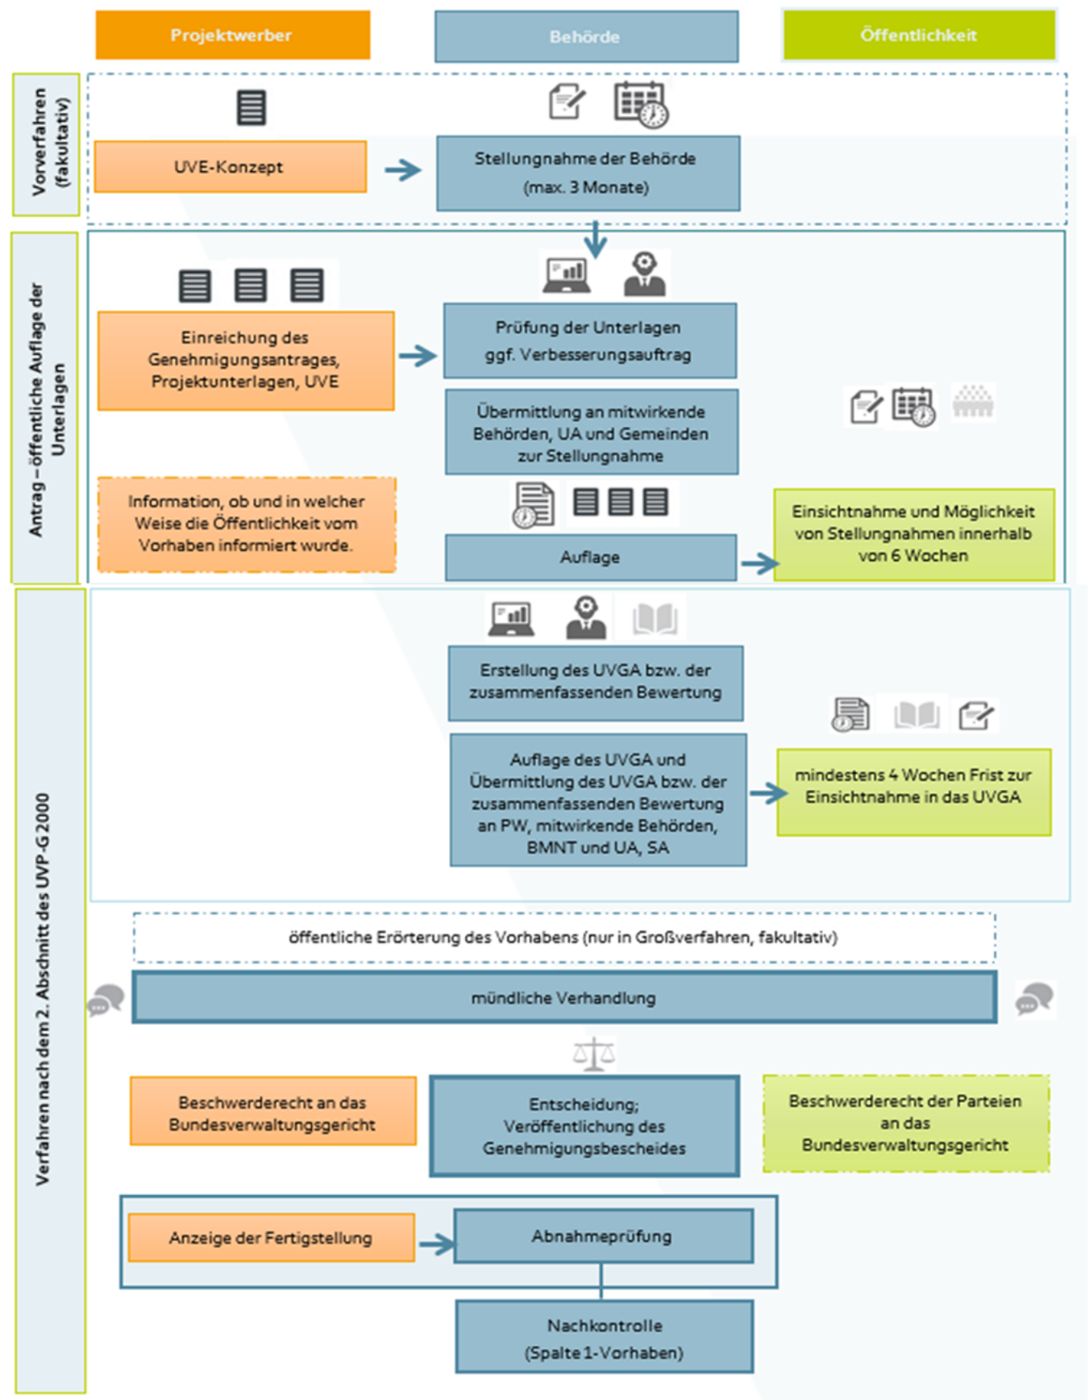
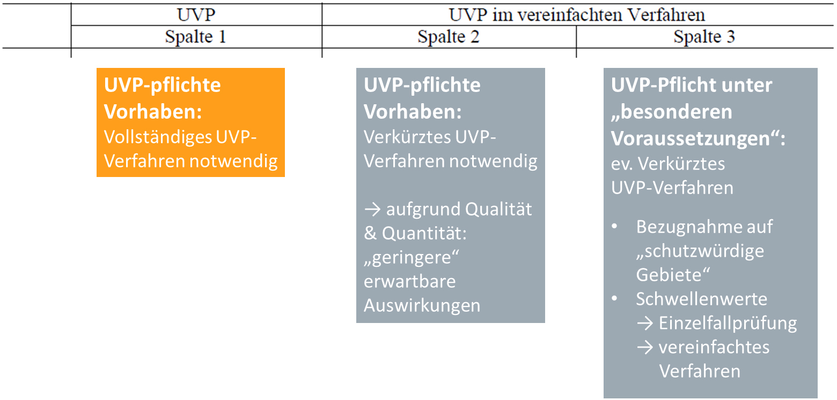
What procedure is used in an EIA? 1/2
Full UVP: 👇 “Spalte 1” projects
UVP-pflichte Vorhaben: Vollständiges UVP-Verfahren notwendig
UVP-pflichte Vorhaben: Verkürztes UVP-Verfahren notwendig
→ aufgrund Qualität & Quantität: „geringere“ erwartbare Auswirkungen
UVP-Pflicht unter „besonderen Voraussetzungen“: ev. Verkürztes UVP-Verfahren
Bezugnahme auf „schutzwürdige Gebiete“
Schwellenwerte → Einzelfallprüfung → vereinfachtes Verfahren

Slide 36

Digression: Sometimes Things are not so Clear

Slide 37
Digression: Feststellungsverfahren
Determination procedure ("individual case assessment") 👉 examination of whether an EIA obligation exists
Involved actors:
By project applicant, public authorities & Umwelt- & Standortanwalt
Plus: Gemeinden = party status 👉 can lodge an objectionen
Duration: 6 weeks
Goal: Provide clarity for parties involved

Slide 38
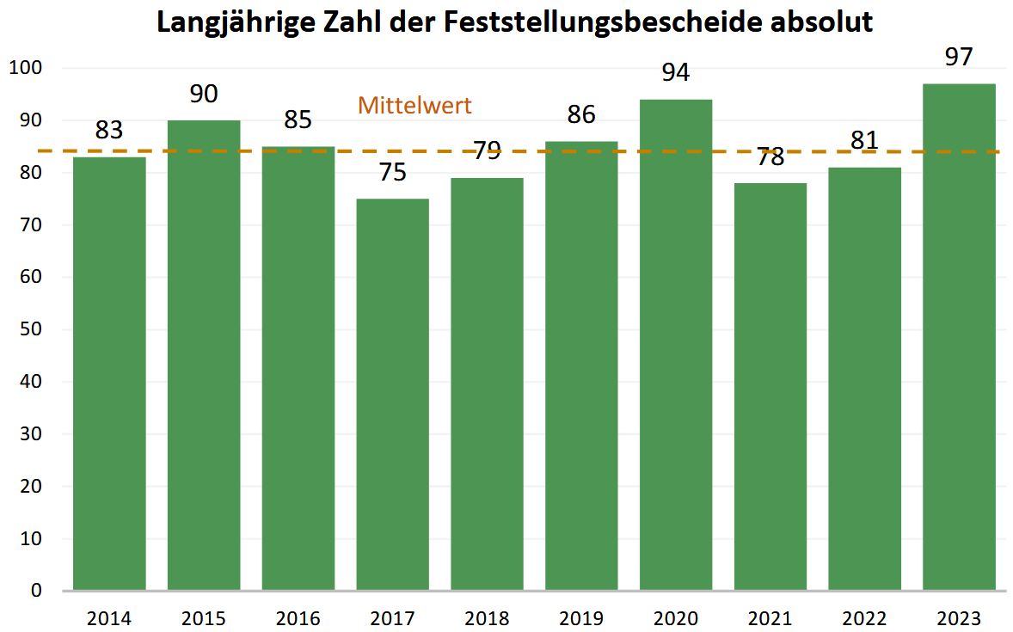
Digression: Feststellungsverfahren

Slide 39
What procedure is used in an EIA? 1/2
Full UVP: 👇 “Spalte 1” projects
UVP-pflichte Vorhaben: Vollständiges UVP-Verfahren notwendig
UVP-pflichte Vorhaben: Verkürztes UVP-Verfahren notwendig
→ aufgrund Qualität & Quantität: „geringere“ erwartbare Auswirkungen
UVP-Pflicht unter „besonderen Voraussetzungen“: ev. Verkürztes UVP-Verfahren
Bezugnahme auf „schutzwürdige Gebiete“
Schwellenwerte → Einzelfallprüfung → vereinfachtes Verfahren

Slide 40
@ Vorverfahren
Vorverfahren = "scoping"
Voluntary 👉 Certainty about the assessment framework
Determination of assessment priorities (= Schutzgüter) for impact statement (Umweltverträglichkeitserklärung UVE)
Project applicant prepares „UVE Konzept"
Rough project description
Proposal on included Schutzgüter, their parameters & assessment procedure
EIA authority "comments on this" 👉 informal
Information on deficiencies etc.
Public participation: no legal requirement

Slide 41
@ Umweltverträglichkeitserklärung UVE
With authorisation application to the EIA authority
Contents:
Description of the project: space requirements, emissions, energy requirements, etc.
Incl. mandatory climate- & energy concept
Alternatives to the project
Description of the current state of the environment
Description Impacts incl. interrelationships between protected assets
Humans, animals, plants and their habitats, soil, water, air, climate, landscape, material and cultural assets
Measures for avoidance
Generally understandable („allgemeinverständliche“) summary
Difficulties with compiling data & documents

Slide 42
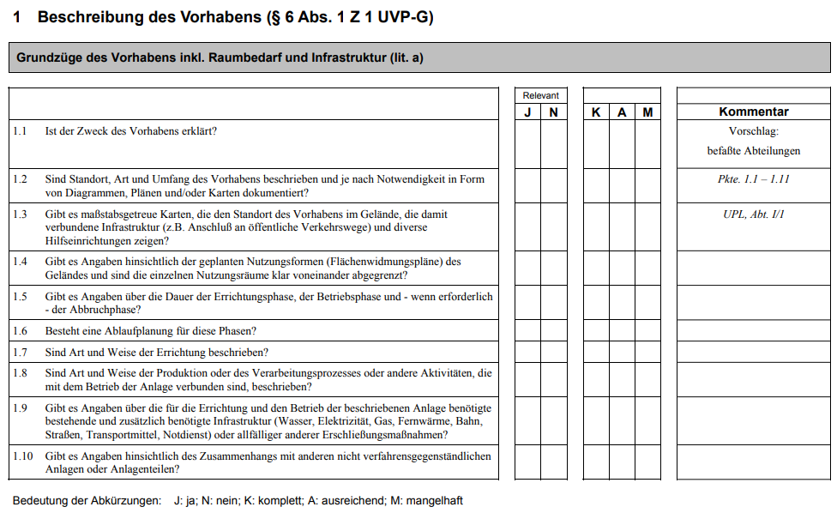
@ Description of the Project

Slide 43
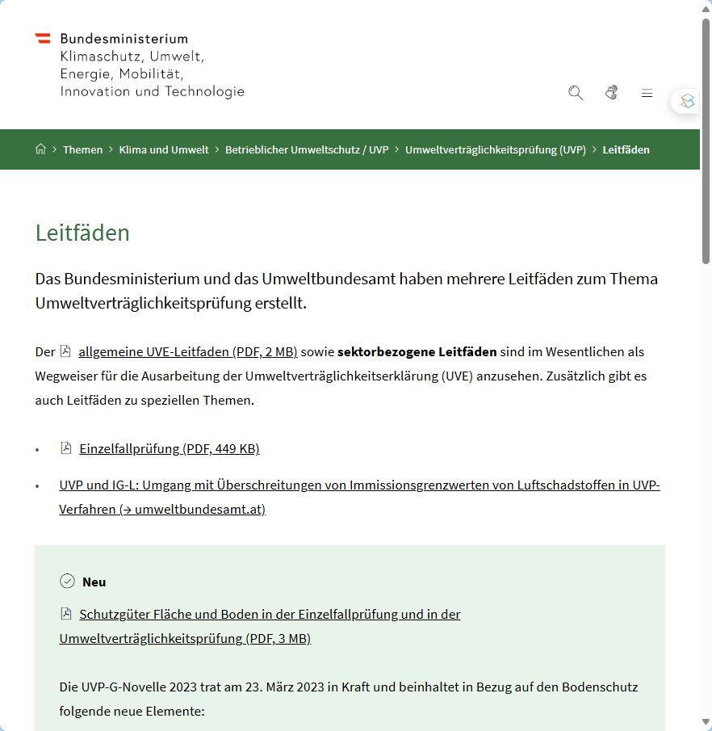
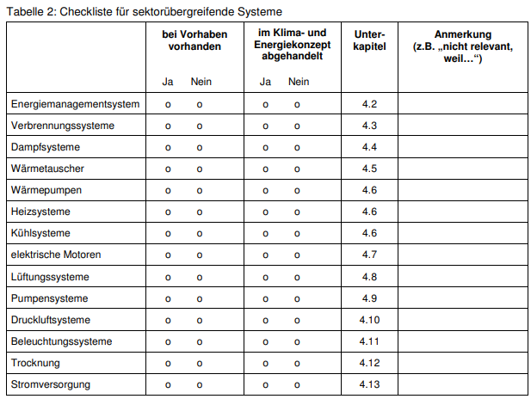
@ Description of the Project
Example: Climate- & Energy-concept

Slide 44
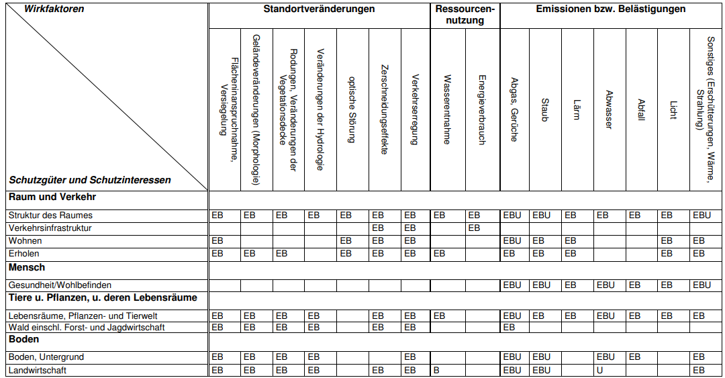
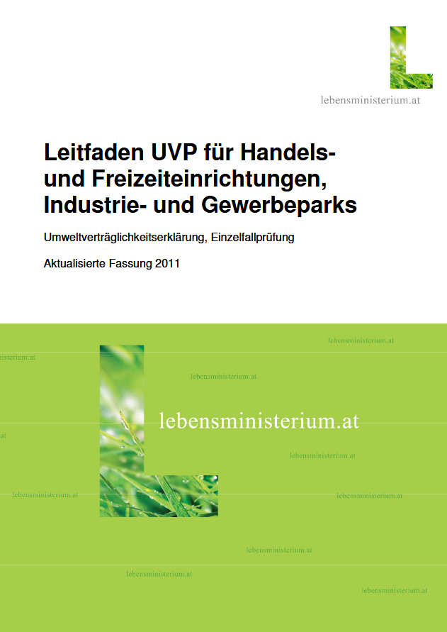
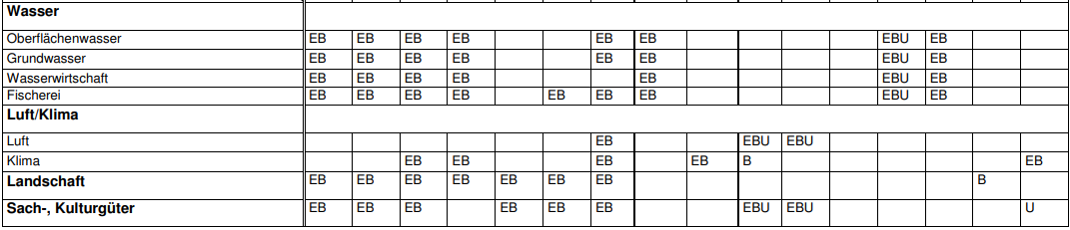
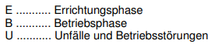
Description of Impacts in the UVE

Slide 45
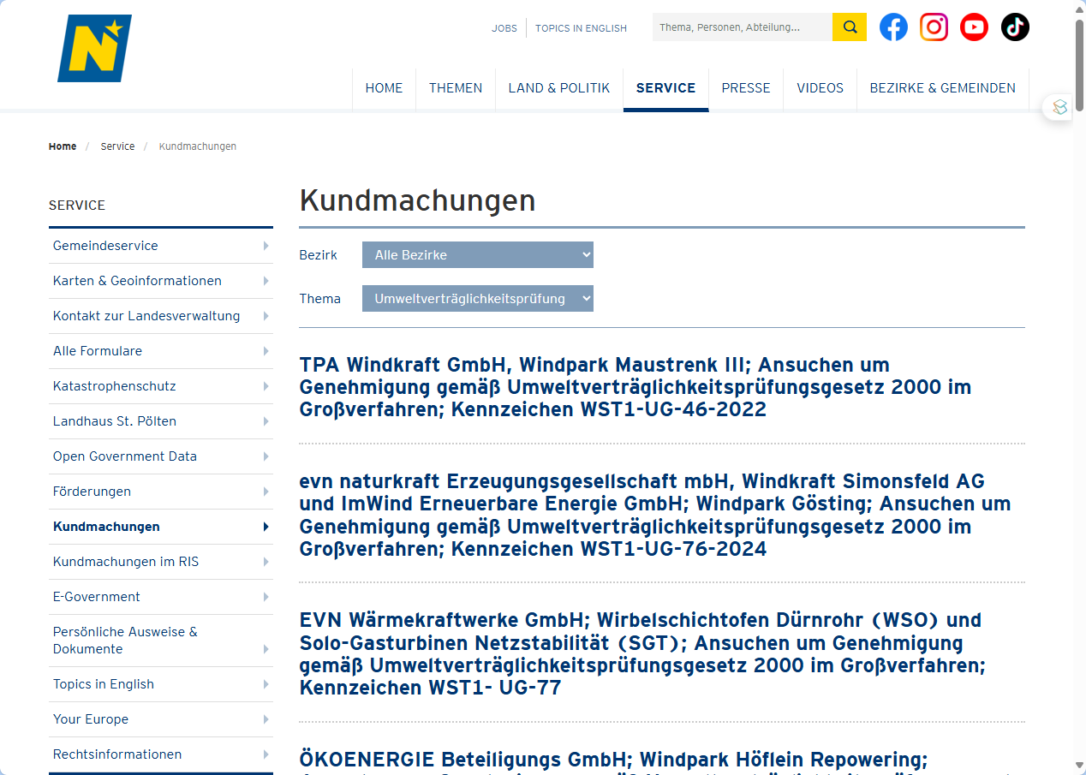
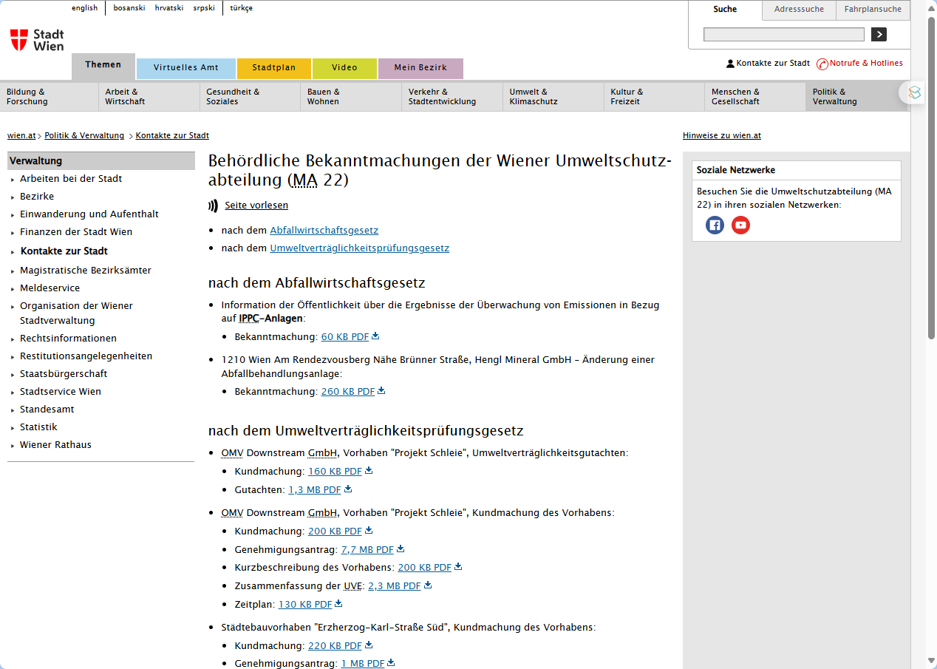
Exemplary UVEs

Slide 46
What procedure is used in an EIA? 2/2

Slide 47
And if You are not Happy with the Outcome?
1st instance: Federal state government (most often environmental department)
"Concentrated procedure = 1 licence application 👉 1 decision
Except:
High-capacity railway lines
Motorways
👉 BMK: Bundesministerium für Klimaschutz, Umwelt, Energie, Mobilität, Innovation und Technologie
2nd instance: Bundesveraltungsgericht
(3rd instance: Verfassungsgerichtshof or Verwaltungsgerichtshof)

Slide 48
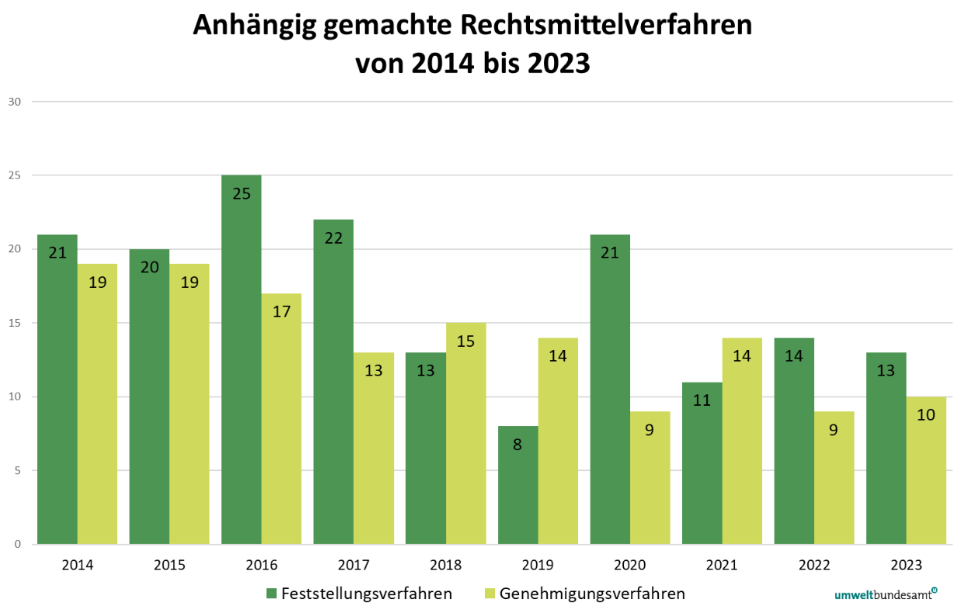
And if You are not Happy with the Outcome?

Slide 49
A Selection of Tools:
 | Focus on …
 | Substance |  | Procedure
Voluntary
Mandatory
Carbon Neutral
Cradle to Cradle
Further CSR activites
Life Cycle Assessment
Österr. Umweltzeichen
B-Corp
ESG reporting: GRI, SASB, ISSB etc.
Climate-focused reporting: TCFD & CDP
Social-focused standards: SA8000
Sector-specific standards: OECD Due Diligence Minerals
XY
Environmental Management
Sustainability Management
EU CSRD
ISO 14001 EMAS
XY
EU Industrial Emissions Directive (IED)
EU Corporate Sustainability Due Diligence Directive (CSDDD)
EU Emissions Trading System (ETS)
EU Green Claims Directive
Env. Impact Assessment (EIA)
Nat. regulations on air, waste, water & soil

Slide 50
Environmental regulations for operating facilities

Slide 51
What is a “Betriebsanlage”?
🤔

Slide 52
What is a “Betriebsanlage”?
Any fixed facility regularly used for conducting business activities:
buildings, rooms, open spaces & equipment 👉 forming a functional unit
restaurants, workshops, stores, warehouses, etc.
Why regulate these facilities – is this not already covered in EIAs?
@ EIA: only for “big” facilities
@ Why:
Business operations have to comply with safety, environmental & zoning regulations
👉 protect public interests

Slide 53
Again: Some important Questions
What is the legal foundation in AUT?
Which actors are involved?
What are the goals of regulating operational facilities?
How is this assessment process structured?

Slide 54
What is a “Betriebsanlage”?
Any fixed facility regularly used for conducting business activities:
buildings, rooms, open spaces & equipment 👉 forming a functional unit
restaurants, workshops, stores, warehouses, etc.
Why regulate these facilities – is this not already covered in EIAs?
@ EIA: only for “big” facilities
@ Why:
Business operations have to comply with safety, environmental & zoning regulations
👉 protect public interests

Slide 55
Digression: Zoning Regulations?
Spatial Planning

Slide 56
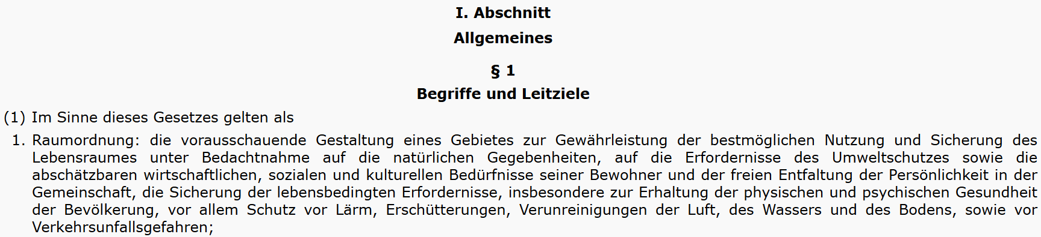
Digression: Spatial Planning
9 different spatial planning laws:

Slide 57
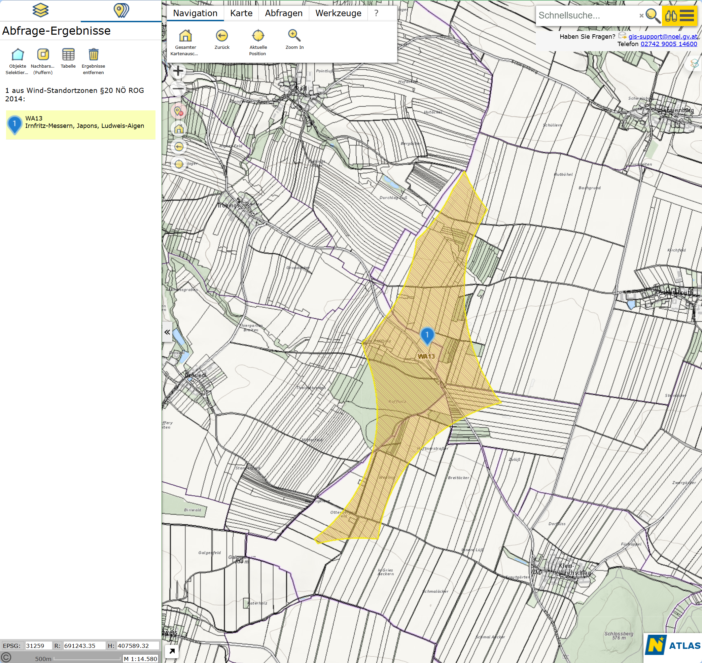
Digression: Zoning Regulations?
LGBl. 8001/1-0: Sektorales Raumordnungsprogramm über Windkraftnutzung in NÖ
71 zones
~ 28,000 ha
„Grünland – Windkraftanlage“

Slide 58
Digression: Zoning Regulations?
NÖ Raumordnungsgesetz e.g. §16, Abs. 1, Z.3 & 4:
Kerngebiete, die für öffentliche Gebäude, Versammlungs- und Vergnügungsstätten, Wohngebäude sowie für Betriebe bestimmt sind, welche sich dem Ortsbild eines Siedlungskernes harmonisch anpassen und keine das örtlich zumutbare Ausmaß übersteigende Lärm- oder Geruchsbelästigung sowie sonstige schädliche Einwirkung auf die Umgebung verursachen.
Betriebsgebiete , die für Bauwerke solcher Betriebe bestimmt sind, die keine übermäßige Lärm- oder Geruchsbelästigung und keine schädliche, störende oder gefährliche Einwirkung auf die Umgebung verursachen […]. Betriebe, die einen Immissionsschutz beanspruchen oder voraussichtlich mehr als 100 Fahrten von mehrspurigen Kraftfahrzeugen pro ha Baulandfläche und Tag – abgestellt auf den jährlich durchschnittlichen täglichen Verkehr an Werktagen – erzeugen, sind unzulässig.

Slide 59
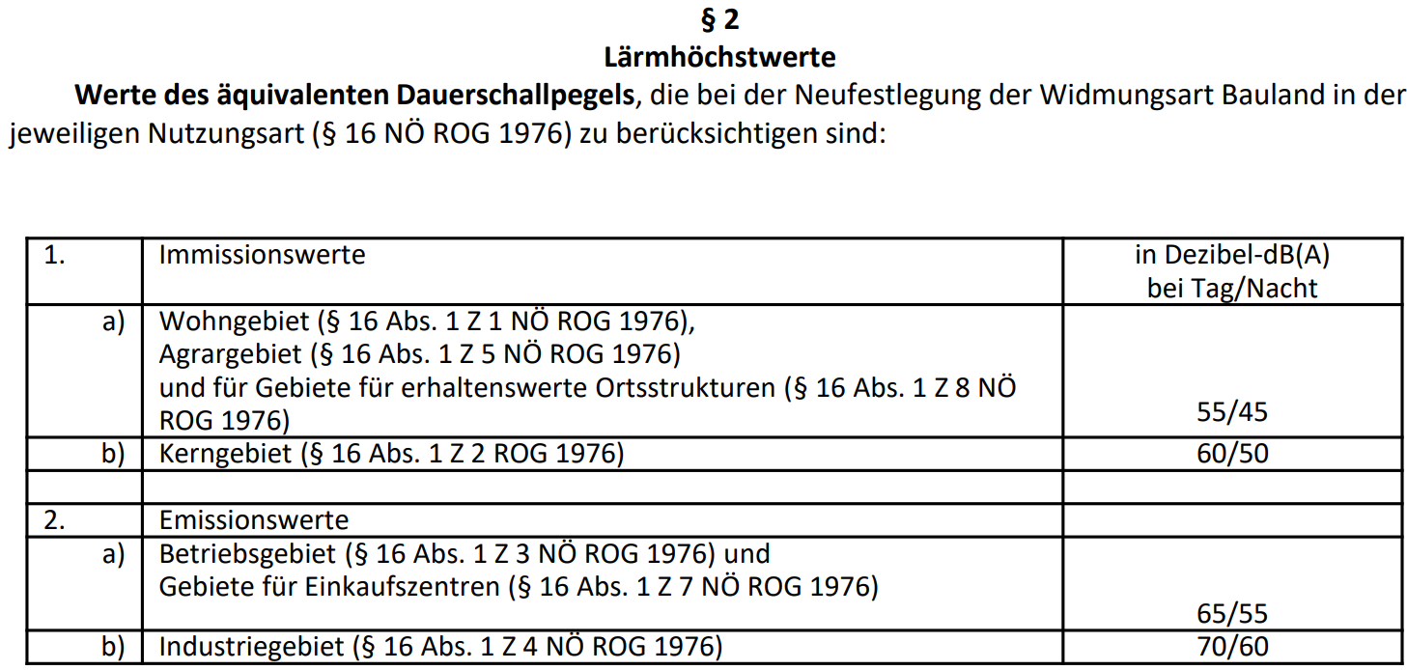
Digression: Zoning Regulations?
NÖ: Verordnung über die Bestimmung des äquivalenten Dauerschallpegels bei Baulandwidmungen LGBl. 8000/4-0

Slide 60
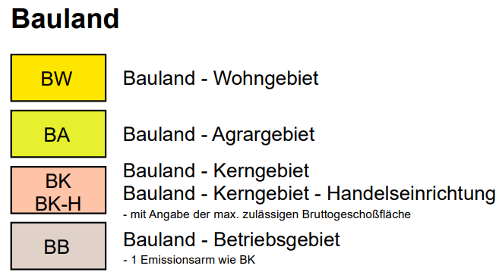
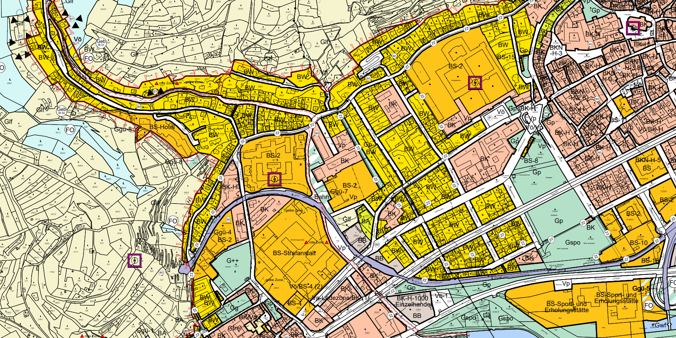
Digression: Zoning Regulations?

Slide 61
What is the Legal Foundation in AUT?
Zoning regulations: 👉 Where & permissible immissions
Austrian Trade Regulation Act („Gewerbeordnung 1994“):
Which operating facilities need a license?
Negative definition via §1 Genehmigungsfreistellungsverordnung:
Einzelhandelsbetriebe bis 600 m² (einschließlich Lebensmittelhandel): „Einzelhandel“ ist als Betriebstype anzusehen, […] Uhren- und Schmuckhandel, Textilhandel, Papierhandel, Blumenhandel/Floristik, Drogerien/Parfümerien, Foto/Optik, Spielwarenhandel, Handel mit Elektrogeräten usw.
Bürobetriebe
Lager
Kosmetik- Fußpflege- und Massagebetriebe
Frisöre, Floristen und Bandagisten
Änderungsschneidereien und Schneidereien mit haushaltsähnlichen Nähmaschinen
Schuhservicebetriebe
Fotografen
Dentalstudios und gewerbliche zahntechnische Labors
Beherbergungsbetriebe bis 30 Gästebetten
Eissalons
Übernahmestellen für Textilreiniger und Wäschebügler
Rechenzentren
Betriebsanlagen im Rahmen einer Eisenbahnanlage, eines Flugplatzes, eines Hafens oder einer Krankenanstalt
…

Slide 62
Again: Some important Questions
What is the legal foundation in AUT?
Which actors are involved?
What are the goals of regulating operational facilities?
How is this assessment process structured?

Slide 63
Which Actors are Involved?
Who is in charge of the licensing process?
Bezirksverwaltungsbehörde (Bezirkshauptmannschaft or Magistrat) 👉 “Gewerbejurist” as coordinator
Involved actors:
Applicant(s): incl. their planners
Specialists with the Bezirksverwaltungsbehörde: Mechanical engineering etc.
Experts from other authorities: labour inspectorate, fire brigade, environmental or water agency
Neighbours

Slide 64
What will be Assessed?
The factual capacity of the planned facility to:
endanger life or health of the business operator, neighbours, or customer
Pose a threat to the property or other tangible rights of neighbours
Cause nuisance to neighbours via odours, smoke, dust, vibrations or other means
Significantly impact traffic safety and flow
Adversely affect water quality
Disrupt public institutions like religious practices, teaching in schools, operation of hospitals, etc.

Slide 65
Again: Some important Questions
What is the legal foundation in AUT?
Which actors are involved?
What are the goals of regulating operational facilities?
How is this licensing process structured?

Slide 66
How is the Licensing Process Structured?
Project planning & application preparation:
often with external consultants like Ziviltechniker or Teschnische Büros
Contacting the Bezirksverwaltungsbehörde:
👉 informal scoping of approval requirements​
Submitting the application
Review of formal correctness & approval necessity:
project is a) exempt from approval, b) subject to notification, or c) requires approval​
Examination of the application
Most often: oral hearing (on site)
hearing involving neighbors if deemed necessary​
Internal evaluation & decision phase
Issue of formal decision (“Bescheid”):
Positive = operating license (with conditions)

Slide 67
How is the Licensing Process Structured?
Project planning & application preparation:
often with external consultants like Ziviltechniker or Teschnische Büros
Contacting the Bezirksverwaltungsbehörde:
👉 informal scoping of approval requirements​
Submitting the application
Review of formal correctness & approval necessity:
project is a) exempt from approval, b) subject to notification, or c) requires approval​
Examination of the application
Most often: oral hearing (on site)
hearing involving neighbors if deemed necessary​
Internal evaluation & decision phase
Issue of formal decision (“Bescheid”):
Positive = operating license (with conditions)
Operating license = precondition for start of construction

Slide 68
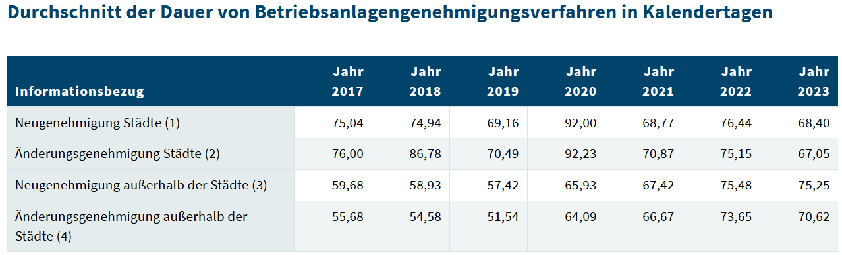
How long does it Take?

Slide 69
What Information has to be included in the Application?
Formal application (= predefined form)
List of owners of neighbouring properties 👉 Grundbuch
Description of the operational facility: incl. plan illustrations
Operating procedure(s)
Mechanical equipment with details of connected loads, installation location & type of installation
Building description: building materials used, technical details of the building, fire protection precautions
Detailed operating procedures:
Workflows: material & machinery use, durations, number of employees involved
Substances and materials used with safety data sheets
Waste management concept
Operating hours
Means of transport and conveyance incl. arrivals & departures with time & frequency information

Slide 70
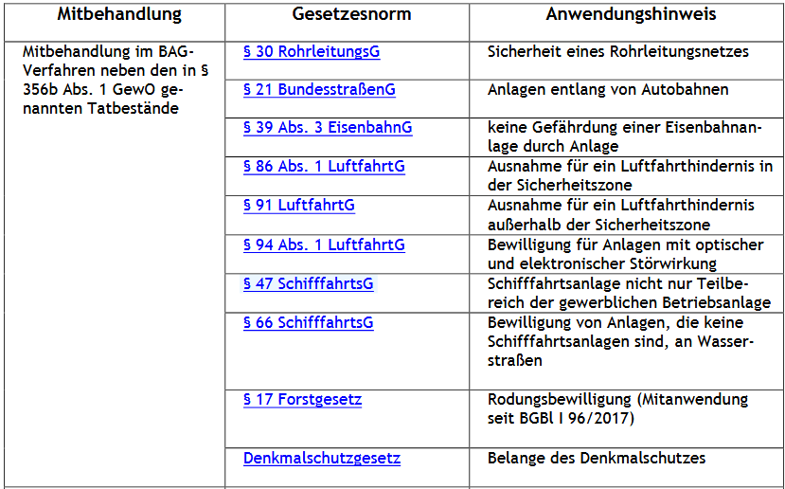
What Information has to be included in the Application?
Not included:
Building permit
Water rights notice
Nature conservation authorisations
E.g. projects in protected areas

Slide 71

What Information has to be included in the Application?

Slide 72
Is one Initial License Enough?
No: § 82b Gewerbeordnung (GewO) 1994
Every 5 years: Regular inspection
6 years for smaller facilities
Review by:
Owner of the plant (if qualified) or his/her employes
Ziviltechniker / Technische Büros
Test centres
Inspection report: no defects 👉 remains in facilty for on site inspections
Defects: proposals including reasonable deadlines for remedying the defects & implemented measures

Slide 73

Is one Initial License Enough? Maybe …
Inter-linkage between re-certifying operational facilities & environmental management systems like
ISO14001
EMAS

Slide 74
So …
 | Focus on …
 | Substance |  | Procedure
Voluntary
Mandatory
Carbon Neutral
Cradle to Cradle
Further CSR activites
Life Cycle Assessment
Österr. Umweltzeichen
B-Corp
ESG reporting: GRI, SASB, ISSB etc.
Climate-focused reporting: TCFD & CDP
Social-focused standards: SA8000
Sector-specific standards: OECD Due Diligence Minerals
XY
Environmental Management
Sustainability Management
EU CSRD
ISO 14001 EMAS
XY
EU Industrial Emissions Directive (IED)
EU Corporate Sustainability Due Diligence Directive (CSDDD)
EU Emissions Trading System (ETS)
EU Green Claims Directive
Env. Impact Assessment (EIA)
Nat. regulations on air, waste, water & soil

Slide 75
An interim conclusion

Slide 76
So …
 | Focus on …
 | Substance |  | Procedure
Voluntary
Mandatory
Carbon Neutral
Cradle to Cradle
Further CSR activites
Life Cycle Assessment
Österr. Umweltzeichen
B-Corp
ESG reporting: GRI, SASB, ISSB etc.
Climate-focused reporting: TCFD & CDP
Social-focused standards: SA8000
Sector-specific standards: OECD Due Diligence Minerals
XY
Environmental Management
Sustainability Management
EU CSRD
ISO 14001 EMAS
XY
EU Industrial Emissions Directive (IED)
EU Corporate Sustainability Due Diligence Directive (CSDDD)
EU Emissions Trading System (ETS)
EU Green Claims Directive
Env. Impact Assessment (EIA)
Nat. regulations on air, waste, water & soil

Slide 77

So … Setting the Playfield
EIA & (re-)licensing an operational facility:
Fokus: 👉 Complying with legal standards:
Spatial planning
Environmental laws
Labour law
Technical laws & regulations regarding safety
Diverse material laws
Austrian Trade Regulation Act

Slide 78
Where to Start? At the Beginning

Slide 79



















So … Setting the Playfield
Company XY

Slide 80

Setting the Playfield?
Flashback: Goals of environmental management 👉
👇 Are we missing something? 👇
Company XY
Company XY

Slide 81
So … Some more Steps to setting the Playfield
Company XY

Slide 82
Waste-management

Slide 83
What is Waste?
🤔

Slide 84
Waste according to the Austrian Waste Management Act (AWG 2002)
Subjective aspect:
any movable object that the owner discards or intends to discard
👉 driven by the owner's intention to dispose of the item
Objective aspect:
Waste also comprises movable objects whose collection, storage, transport, or treatment is necessary to prevent adverse effects on public interests
👉 necessity of management to protect public health & order & the environment

Slide 85

What is Waste? 🔗 Abfallverzeichnisverordnung 2020

Slide 86
What is Waste? 🔗 Abfallverzeichnisverordnung 2020
Based on European Waste Catalogue (EWC):
First 2 digits: waste chapter
Middle 2 digits: chapter subgroup
Last 2 digits: specific waste type
👉 AUT: no spaces & no last leading zeros

Slide 87
EU Waste Chapters
11 – Wastes from chemical surface treatment and coating of metals and other materials
12 – Wastes from shaping and physical and mechanical surface treatment of metals and plastics
13 – Oil wastes and wastes of liquid fuels (except edible oils, and those in chapters 05, 12 and 19)
14 – Wastes from organic solvents, refrigerants and propellants (except 07 and 08)
15 – Waste packaging; absorbents, wiping cloths, filter materials and protective clothing not otherwise specified
16 – Wastes not otherwise specified in the list
17 – Construction and demolition wastes (including excavated soil from contaminated sites)
18 – Wastes from human or animal health care and/or related research
19 – Wastes from waste management facilities, off-site wastewater treatment plants and the preparation of water intended for human consumption and water for industrial use
20 – Municipal wastes (household waste and similar commercial, industrial and institutional wastes), including separately collected fractions
01 – Wastes resulting from exploration, mining, quarrying, and physical and chemical treatment of minerals
02 – Wastes from agriculture, horticulture, aquaculture, forestry, hunting and fishing, food preparation and processing
03 – Wastes from wood processing and the production of panels and furniture, pulp, paper and cardboard
04 – Wastes from the leather, fur and textile industries
05 – Wastes from petroleum refining, natural gas purification and pyrolytic treatment of coal
06 – Wastes from inorganic chemical processes
07 – Wastes from organic chemical processes
08 – Wastes from the manufacture, formulation, supply and use of coatings (paints, varnishes and vitreous enamels), adhesives, sealants and printing inks
09 – Wastes from the photographic industry
10 – Wastes from thermal processes

Slide 88
Waste according to the Austrian Waste Management Act (AWG 2002)
Why?
Minimise harmful or detrimental effects on people, animals, plants, their livelihoods & their natural environment
Conservation of raw material and energy reserves
Minimising the use of landfill space
Only materials as waste whose disposal poses no potential risk to future generations 👉 precautionary principle

Slide 89

How to Deal with Waste?
👉 EU Waste Framework Directive:
Waste Prevention: avoid generation of waste
​Preparation for Reuse: Inspect, clean, and repair products or components 👉 enable their reuse
Recycling: Process waste materials into new products 👉 prevent resource consumption​
Recovery: energy recovery
Disposal: Safely dispose of waste
landfilling or incineration without energy recovery

Slide 90
Special Case: Dangerous Waste
Obligation to report 👉 Elektronisches Datenmanagement EDM
If no appropriate in-house treatment 👉 handover to authorised waste collectors
Obligation consignment note 👉 Elektronisches Datenmanagement EDM
Prohibition of mixing if this makes treatment more difficult
Proper intermediate (= on-site) storage 👉 technical standards

Slide 91


Who the Hell should Know all This?
👉 Meet the “Abfallbeauftragte*r”:
Mandatory > 100 employees
Can be outsourced
Compliance with the Waste Management Act 👉 EDM filings
Implement & organise waste regulations in the company
Advising company owners on waste management aspects of procurement
👉 in charge of formulating a waste management concept (“Abfallwirtschaftskonzept”)

Slide 92


Deluxe Edition: Who the Hell should Know all This?
Notes:
VbF Verordnung brennbare Flüssigkeiten
ChemVO: Chemikalienverordnung
AschG: Arbeitsschutzgesetz

Slide 93
Waste Management Concept WMC (“Abfallwirtschaftskonzept”)
🤔

Slide 94
Waste Management Concept WMC (“Abfallwirtschaftskonzept”)
When do I need a WMC?
Installations requiring authorisation according to the Austrian Trade Regulation Act
Installation requiring authorisation according to the Mineral Resources Act
> 20 employees
At the latest 12 months after 21st employees
installation, commissioning & modification

Slide 95

WMC – What’s Inside?
Sector, purpose and plant components
General information on facility, branch & products/services
Short description of processes & plant components
Process-related representation
Detailled description of processes (= capacities) resulting in waste
List of waste-relevant input materials
Waste-related presentation
Detailled description (quality & quantity) of produced waste
In-house & external waste logistics
Description of measures already implemented in the past to limit waste quantity & quality
Presentation of the organisational precautions for compliance
Name of „Abfallbeauftragte*r“, Compliance with recording & filing obligations
Assessment of future developments
Planned changes in production processes, activities to limit waste quantity & quality

Slide 96

WMC – What’s Inside?

Slide 97

WMC – Some Guidance
👉 sector-specific focal points in representations
WKO & selected administrations offer “Muster”
Stadt Wien: Musterabfallwirtschaftskonzepte
WKO: Branchenspezifische Abfallwirtschaftskonzept-Vorlagen

Slide 98
WMC – One Concept to Rule all Waste?
Update (“Fortschschreibung”):
modifications subject to authorisation (Austrian Trade Regulation Act / Mineral Resources Act)
significant, waste-relevant modification of the plant
New production processes 👉 new waste
Change in waste quantity > 50%
At least every 7 years
Remains with company
👉 submit to the authority on request 👉 non-compliance: up to 3,400€ fine

Slide 99
Again: Interim Conclusion

Slide 100


So … Some more Steps to setting the Playfield
Company XY

Slide 101
What’s Next?
 | Focus on …
 | Substance |  | Procedure
Voluntary
Mandatory
Carbon Neutral
Cradle to Cradle
Further CSR activites
Life Cycle Assessment
Österr. Umweltzeichen
B-Corp
ESG reporting: GRI, SASB, ISSB etc.
Climate-focused reporting: TCFD & CDP
Social-focused standards: SA8000
Sector-specific standards: OECD Due Diligence Minerals
XY
Environmental Management
Sustainability Management
EU CSRD
ISO 14001 EMAS
XY
EU Industrial Emissions Directive (IED)
✅
EU Corporate Sustainability Due Diligence Directive (CSDDD)
EU Emissions Trading System (ETS)
EU Green Claims Directive
Env. Impact Assessment (EIA)
Nat. regulations on air, waste, water & soil
✅
✅

Slide 102
Outlook

Slide 103
Wrap it up
Environmental Impact Assessment (EIA)
large-scale projects with significant environmental impacts 👉 precautionary principle
public participation, scoping, and multi-level licensing procedure
(Re-)Licensing Operational Facilities
Austrian Trade Regulation Act 👉 public interest: health, safety, environment, zoning
application, hearings, formal decision (“Bescheid”)
Waste Management & Waste Management Concept (WMC)
process descriptions, waste streams, logistics, and planning

Slide 104
Till next Session:

Slide 105


So long & cheerio!

